Slide 1
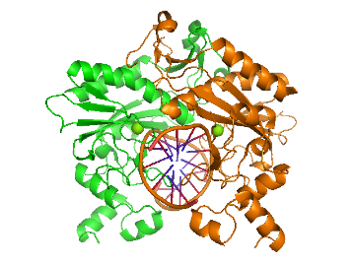
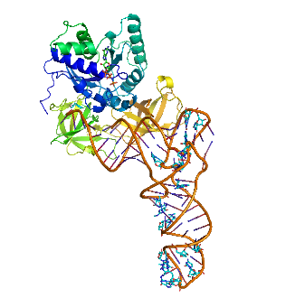
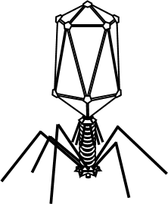





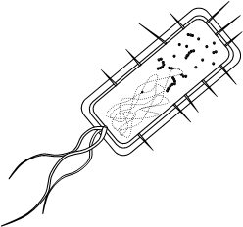
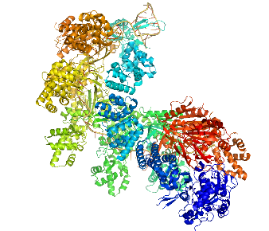
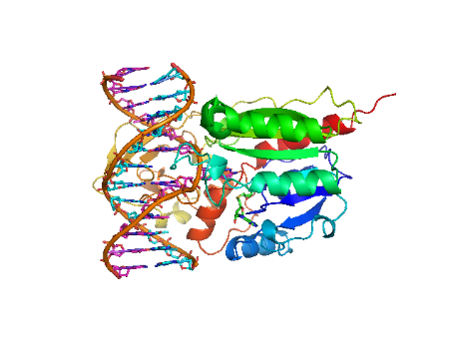
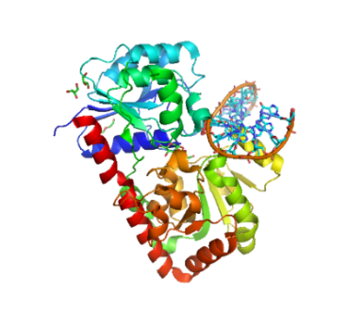
Discard
PHAGE
If host plays RESTRICT
then phage can counter with
METHYLATE – move both cards to the discard pile
Play all other cards here
T
Phage enters host unless host can
LOCK
it out on the first move
0
1
2
3
WIN
0
1
2
3
WIN
HI, DROXYLATE and
SWEET RELEASE defeat METHYLATE
but stay in play until cancelled
METHYL-ACE
& METHYL-ATE defeat
RESTRICT
but stay in play until cancelled
PURGE
defeats
RESTRICT
but stays in play until cancelled
Discard
HOST

Slide 2
Molecular images from RCSB PDB: CRISPR 4U7U (Zhao et al. 2014); EF-Tu/tRNA^{Phe} 1TTT (Nissen et al. 1995); EcoRV 1SUZ (Horsson et al. 2004); DNA methylase 1MHT (Klimasauskas et al. 1994); DNA glucosyltransferase 1Y6F (Lariviere et al. 2005)
Public domain images from: Desconhecido, Sebastian Alvarez Duran, Clipshrine, 6dsimplemachines
CC-BY-SA-4.0 (https://creativecommons.org/licenses/by-sa/4.0)
Steve Cook (http://www.polypompholyx.com)

Slide 3
RESTRICT
RESTRICT
RESTRICT
RESTRICT
RESTRICT
RESTRICT
You gain the EcoRI restriction enzyme
Cut phage DNA at
GAATTC
6
You gain the EcoRV restriction enzyme
Cut phage DNA at
GATATC
6
You gain the NheI restriction enzyme
Cut phage DNA at
GCTAGC
6
You gain the PstI restriction enzyme
Cut phage DNA at
CTGCAG
6
You gain the BamHI restriction enzyme
Cut phage DNA at
GGATCC
6
You gain the HindIII restriction enzyme
Cut phage DNA at
GAATTC
6
RESTRICT
RESTRICT
RESTRICT
RESTRICT
RESTRICT
RESTRICT
You gain the TaqI restriction enzyme
Cut phage DNA at
TCGA
4
You gain the AhaIII restriction enzyme
Cut phage DNA at
TTTAAA
6
You gain the FunI restriction enzyme
Cut phage DNA at
AGCGCT
6
You gain the HaeIII restriction enzyme
Cut phage DNA at
GGCC
4
You gain the SmaI restriction enzyme
Cut phage DNA at
CCCGGG
6
You gain the NotI restriction enzyme
Cut phage DNA at
GCGGCCGC
8
RESTRICT
RESTRICT
RESTRICT
RESTRICT
RESTRICT
RESTRICT
You gain the KpnI restriction enzyme
Cut phage DNA at
GGTACC
6
You gain the DraI restriction enzyme
Cut phage DNA at
TTTAAA
6
You gain the AscI restriction enzyme
Cut phage DNA at
GGCGCGCC
8
You gain the BssHII restriction enzyme
Cut phage DNA at
GCGCGC
6
You gain the FspI restriction enzyme
Cut phage DNA at
TGCGCA
6
You gain the PvuI restriction enzyme
Cut phage DNA at
CGATCG
6

Slide 5



BURNT TO
A CRISPR
BYE,
DROXYLATE
BITTER
DEFEAT
INHIBIT
T
GET OUT
TREACLE
Your CRISPR system recognises the phage’s DNA and degrades it
YOU WIN, unless the phage immediately counters with “BACKFIRE” card
You gain an enzyme that cuts DNA containing hydroxymethylcytosine
Cancel and discard “HI, DROXYLATE” card
You gain an enzyme that lets you recognise and cut DNA containing sugar-decorated hydroxymethylcytosine
Cancel and discard “SWEET RELEASE” card
You gain an inhibitor of phage methylase
Cancel and discard any “METHYLATE” card
You expel an integrated phage from your DNA
Cancel and discard “TEMPER TAMPER” card
You gain a protein that inhibits protein synthesis by the phage
Discard ONE card from your hand, pick TWO from the deck, PLAY AGAIN immediately
LOCK
LOCK
LOCK
LOCK
ABORT
TREACLE
A mutation changes the shape of a cell-wall protein that the phage binds to
Stop phage infecting you
A mutation changes the shape of a cell-wall protein that the phage binds to
Stop phage infecting you
A mutation changes the shape of a cell-wall protein that the phage binds to
Stop phage infecting you
A mutation changes the shape of a cell-wall protein that the phage binds to
Stop phage infecting you
You undergo programmed death; your sisters take up the fight
Cancel ALL cards in play, but you must PLAY ONE MORE CARD BEFORE refilling your hand
You gain a protein that inhibits protein synthesis by the phage
Discard ONE card from your hand, pick TWO from the deck, PLAY AGAIN immediately
PUPPIES
FOR ALL
PUPPIES
FOR SOME
SWELL
CONFLICT OF INTEREST
DOUBLE
MUTANT
DOUBLE
TROUBLE
You gain an enzyme that pupylates any phage methylase and targets it for destruction
Cancel and discard any “METHLYATE, -ACE or -ATE” card
You gain an enzyme that pupylates standard methylases and targets them for destruction
Cancel and discard any “METHLYATE” (but not “METHYL-ACE /ATE”) card
Your genome becomes larger and more able to maintain antiviral defences
Pick up TWO new cards, PLAY AGAIN, and maintain a hand of FIVE from now on
You are attacked by a different phage, which wipes you out, but also leaves the phage homeless
Both players die, no-one wins this hand
Discard any two cards from your hand
Pick THREE cards, play again immediately
Pick up a card. Play two more cards against the phage.
Phage must counter BOTH cards or lose immediately

Slide 7
METHYLATE
METHYLATE
METHYLATE
METHYLATE
METHYLATE
METHYLATE
You gain methylation that protects your DNA from the EcoRI restriction enzyme
Cancel and discard EcoRI card
You gain methylation that protects your DNA from the EcoRV restriction enzyme
Cancel and discard EcoRV card
You gain methylation that protects your DNA from the NheI restriction enzyme
Cancel and discard NheI card
You gain methylation that protects your DNA from the PstI restriction enzyme
Cancel and discard PstI card
You gain methylation that protects your DNA from the BamHI restriction enzyme
Cancel and discard BamHI card
You gain methylation that protects your DNA from the HindIII restriction enzyme
Cancel and discard HindIII card
METHYLATE
METHYLATE
METHYLATE
METHYLATE
METHYLATE
METHYLATE
You gain methylation that protects your DNA from the TaqI restriction enzyme
Cancel and discard TaqI card
You gain methylation that protects your DNA from the AhaIII restriction enzyme
Cancel and discard AhaIII card
You gain methylation that protects your DNA from the FunI restriction enzyme
Cancel and discard FunI card
You gain methylation that protects your DNA from the HaeIII restriction enzyme
Cancel and discard HaeIII card
You gain methylation that protects your DNA from the SmaI restriction enzyme
Cancel and discard SmaI card
You gain methylation that protects your DNA from the NotI restriction enzyme
Cancel and discard NotI card
METHYLATE
METHYLATE
METHYLATE
METHYLATE
METHYLATE
METHYLATE
You gain methylation that protects your DNA from the KpnI restriction enzyme
Cancel and discard KpnI card
You gain methylation that protects your DNA from the DraI restriction enzyme
Cancel and discard DraI card
You gain methylation that protects your DNA from the AscI restriction enzyme
Cancel and discard AscI card
You gain methylation that protects your DNA from the BssHII restriction enzyme
Cancel and discard BssHII card
You gain methylation that protects your DNA from the FspI restriction enzyme
Cancel and discard FspI card
You gain methylation that protects your DNA from the PvuI restriction enzyme
Cancel and discard PvuI card

Slide 9

BACKFIRE
HI,
DROXYLATE
SWEET
RELEASE
INTERFERE
PURGE
SLOW
-MO
A mutation in your host’s CRISPR system causes it to turn on itself, regardless of any other defences in play
YOU WIN immediately
You gain an enzyme that allows you to methylhydroxylate cytosine in your DNA
Cancel and discard any restriction enzyme that recognises a site containing “C”. Stays in play
You gain an enzyme that attaches glucose to hydroxy-methylcytosine, protecting your DNA
Cancel “HI, DROXYLATE” card. Stays in play
You gain a protein that interferes with the action of a restriction enzyme
Cancel and discard any “RESTRICT” card
Mutations remove long palindromic sequences from your DNA
Cancel and discard any restriction enzyme that recognises a site of length 8. Stays in play
You gain a protein that inhibits protein synthesis by the host
Discard ONE card from your hand, pick TWO from the deck, and PLAY AGAIN immediately
KEY
KEY
KEY
KEY
T
TEMPER
TAMPER
SLOW
-MO
A mutation changes the shape of a tail-fibre protein that you use to stick to bacteria
Cancel and discard a “LOCK” card
A mutation changes the shape of a tail-fibre protein that you use to stick to bacteria
Cancel and discard a “LOCK” card
A mutation changes the shape of a tail-fibre protein that you use to stick to bacteria
Cancel and discard a “LOCK” card
A mutation changes the shape of a tail-fibre protein that you use to stick to bacteria
Cancel and discard a “LOCK” card
You insert into your host’s DNA, inactivating a restriction enzyme
Cancel and discard any “RESTRICT” card unless immediately countered with “GET OUT”
You gain a protein that inhibits protein synthesis by the host
Discard ONE card from your hand, pick TWO from the deck, and PLAY AGAIN immediately
METHYL
-ATE
METHYL
-ACE
SHRINK
STALE
MATE
DOUBLE
MUTANT
GAMBLE
You gain a general methylase that protects your own DNA from several restriction enzymes
Cancel and discard any restriction enzyme with an “A” in its site. Stays in play
You gain a general methylase that protects your own DNA from several restriction enzymes
Cancel and discard any restriction enzyme with a “C” in its site. Stays in play
Your host’s genome becomes smaller and less able to maintain antiviral defences
Discard ONE card from the host’s hand; they now maintain a smaller hand. Pick up a new card, PLAY AGAIN
The host is a human pathogen, and someone has discovered an antibiotic against it: the host dies, but so do you!
Both players die, no-one wins this hand
You are irradiated by X-rays
Discard any TWO cards from your hand, pick THREE new cards, play again immediately
You steal a restriction enzyme from a different bacterium and play it against the host
Pick ONE card from the host’s deck. If it is “RESTRICT”, WIN immediately; if not, LOSE immediately

Slide 11



RULES
RULES
Two players (or teams)
Each player/team maintains a hand of 4 cards
Host always plays first
If phage can counter host’s play, discard both cards, and host plays again: carry on until host can’t play or phage can’t counter
Read the instructions on the cards carefully!
  LOCK/KEY cards can only be played on first move
  RESTRICT/METHYLATE cards are your “standard” weapons
  Cards with stars remain in play for the hand (or until cancelled)
  Cards with bombs can be played before your counter-move or have other special properties
  Cards with skulls kill both players
When you win a hand, shuffle, move score-counter, and swap: host becomes phage and vice versa.
First to 5 wins!
Two players (or teams)
Each player/team maintains a hand of 4 cards
Host always plays first
If phage can counter host’s play, discard both cards, and host plays again: carry on until host can’t play or phage can’t counter
Read the instructions on the cards carefully!
  LOCK/KEY cards can only be played on first move
  RESTRICT/METHYLATE cards are your “standard” weapons
  Cards with stars remain in play for the hand (or until cancelled)
  Cards with bombs can be played before your counter-move or have other special properties
  Cards with skulls kill both players
When you win a hand, shuffle, move score-counter, and swap: host becomes phage and vice versa.
First to 5 wins!

