Slide 1
Editing Wikipedia
Community Payback for undergraduates
CC-BY-SA-3.0 Steve Cook (www.polypompholyx.com)
© London Borough of Hammersmith and Fulham

Slide 2
Wikipedia five pillars (5P)
Encyclopaedia
Notable topics
No original research (NOR)*
Neutral point of view (NPOV)
Verifiability (refs)
Free content
Anyone can edit
No copyright infringements
Be civil
No firm rules
Notes:
* No original research means no 'new' data, i.e. you should not be presenting un-peer-reviewed data you have collected personally and want to 'publish'. It does not mean 'no journal articles'.

Slide 3
Creating an account
English Wikipedia
DO NOT USE YOUR COLLEGE USERNAME OR PASSWORD

Slide 4
Edit a page in the edit tab
Edit tab
Wiki mark-up into the textbox widget
Summary of your edit into text widget
Text you submit is irrevocably released to the world
Free for others to use and modify
But the authorship must be credited

Slide 5
Use your sandbox
Open sandbox
Create a draft of your article in your sandbox
Use the Preview when editing live pages
History updated with each Save
Save
Preview

Slide 6
Basic article layout
Article title
Lead section (intro)
'''First mention of title''' in leader
Sections
==Section==
Subsections
===Subsection===
Notes & references
==References==
{{Reflist}}
External links
==External links==
* [http://example.com/link Text]
* [http://example.com/foobar Blah]

Slide 7
Wiki mark-up for text formatting
Mark-up | Result
==Section heading== | Section heading
===Subsection heading=== | Subsection heading
'''Something bold''' | Something bold
''Latin name in italics'' | Latin name in italics
blank line | (paragraph break)
* unordered list item | unordered list item
# ordered list item | ordered list item
H<sub>2</sub> | H₂
<sup>4</sup>He | ⁴He
&alpha; | α (other HTML mark-up also works)
Notes:
Tables are also possible. I leave it up to you to look up the syntax if you need it.

Slide 8
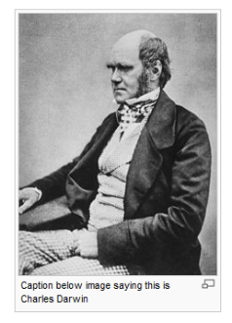
Wiki mark-up for linking and images
Mark-up | Example | Result
[[internal_link]] …or… [[internal link]] | [[Drosera_aliciae]] | Drosera aliciae Underscores are optional
[[internal_link|Text for link]] | [[Drosera_aliciae|Alice sundew]] | Alice sundew Note double braces and pipe
[http://example.com/external_link Text for link] | [http://www.imperial.ac.uk Imperial College] | Imperial college Note single braces and no pipe
[[File:image.jpg | 200px | thumb | alt=Description of the image for the visually impaired|Caption below image]] | [[File:Charles_Darwin_seated.jpg | 200px | thumb | alt=Darwin seated facing left, no beard]] | Thumb (not compulsory! floats right by default
Public domain image

Slide 9
Wiki mark-up for references*
Oceania has always been at war with Eastasia
<ref name="Goldstein1984">
{{Cite journal | author=Goldstein E | title=The theory and practice of oligarchical collectivism | journal=[[Journal of the Brotherhood]] | volume=1 | year=1984 | pages=1-666 | doi=mini.luv/eablair.1949 }}
</ref>
==References==
{{Reflist}}
Notes:
*If you want to use a reference twice in the same article, do not type it twice, use:
<ref name="Goldstein1984">{{Cite journal | blahblahblah }}</ref>
the first time, and then use
ref name="Goldstein1984" />
the second time. The name attribute of the ref tag is not compulsory, but I advise you to use it for all your references, so it's easier for other editors to recite your citations.

Slide 10
Replicate the page below*
"Contents" is added automagically
Internal link to "Wood preservation"
Heading
Bold
Subscripts
Subheading
Italics
Internal link (no article)
Heading
HTML right-arrows
Heading
Image link to "Pentachlorophenol-structure.png"
Bullets
External link to http://water.epa.gov/drink/contaminants/basicinformation/pentachlorophenol.cfm
"References" formatted automagically, but you need to create the reference in the body-text
Notes:
*Note that this 'article' breaks the manual of style conventions in that it has a heading at the top, rather than a leader section.

Slide 11
Selecting a page to edit
Open talk (discussion) tab
Edit tab
Start from a stub
http://en.wikipedia.org/wiki/Category:Biology_stubs
http://en.wikipedia.org/wiki/Category:Enzyme_stubs
http://en.wikipedia.org/wiki/Category:Plant_stubs
…or improve a pre-existing article
Approve intended page with me via BlackBoard

Slide 12
Scan the history
View history
Choose an article that is not being heavily edited by others already
Scan through past edits
Mostly bots? [automated edits]
Quiet?

Slide 13
Discuss your edit in the talk tab
Read the talk page
Introduce yourself
State that you plan on editing it
Sign off comments with
~~~~
Inserts
Username (talk) datetime
Necessary for 'be civil'

Slide 14
Uploading your own images*
Select file on local drive
Give the file a descriptive name:
"70S ribosome in elongation phase (Pymol rendering)" not "ribosome"
Summary: author, source, etc
Licence
Notes:
* You won’t be able to upload images until you have committed 10 edits, so I suggest you find ten WP articles with typos to correct!

Slide 15
Image licensing*
License | Details
Attribution (BY) | Licensees may copy, distribute, display and perform the work and make derivative works based on it only if they give the author or licensor the credits in the manner specified by these.
Share-Alike (SA) | Licensees may distribute derivative works only under a license identical to the license that governs the original work. (See also copyleft.)
Images must be
Public domain, or
YOUR OWN LICENSED WORK
e.g. Creative Commons CC-BY-SA-3.0
Notes:
* You must NOT upload copyrighted material, or any images from journals. Images should be self-penned and/or public domain.

Slide 16
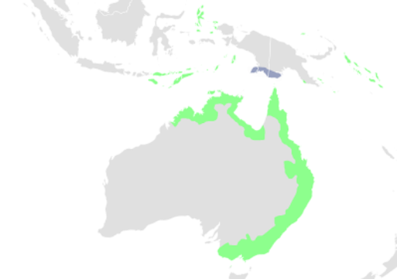
Acceptable images
OK
Not OK
Wikimedia Commons
Self-penned/photo-ed images
SVG maps made with Inkscape
Pymol-generated images from RCSB PDB files
United States Government (NASA, CDC, etc) – images are generally public domain
Images from journals or books
Slavish copies of images from journals or books
Ant24788@Wikimedia
CC-BY-SA-3.0

Slide 17
Taxoboxes and other boxen
{{Taxobox
| image = Drosera aliciae.jpg
| image_width = 230px
| regnum = [[Plant]]ae
| unranked_divisio = [[Flowering plant|Angiosperms]]
| unranked_classis = [[Eudicots]]
| unranked_ordo = [[Core eudicots]]
| ordo = [[Caryophyllales]]
| familia = [[Droseraceae]]
| genus = ''[[Drosera]]''
| species = '''''D. aliciae'''''
| binomial = ''Drosera aliciae''
| binomial_authority = [[R.Hamet]] (1905)
}}
Other boxes exist for genes, enzymes, etc
Polypompholyx@Wikimedia
CC-BY-SA-3.0

Slide 18
Caveat editor
WikiProjects
Beware toe-treading
Conform to applicable WikiProject standards
Plagiarism and self-plagiarism
You MUST NOT plagiarise your own essays, etc.
(or anyone else's, obviously)
Commit your edit whilst logged in
Otherwise it'll be anonymous!

Slide 19
Audience?
You need to judge how to pitch it
You are not writing a UG essay
Who is likely to Google/read it?
General science audience is a default
Quality links may be more important than excruciating detail

